Slide 1

Java101
Crash course in OOP

Slide 2
Background:
Created by James Goslin in 1995.
Acquired by Oracle Corporation.
Compiled & Statically typed
Two current LTS versions:
Java 8
Java 11
Java != JavaScript

Slide 3
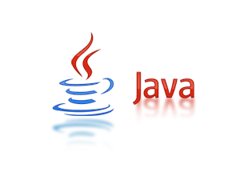

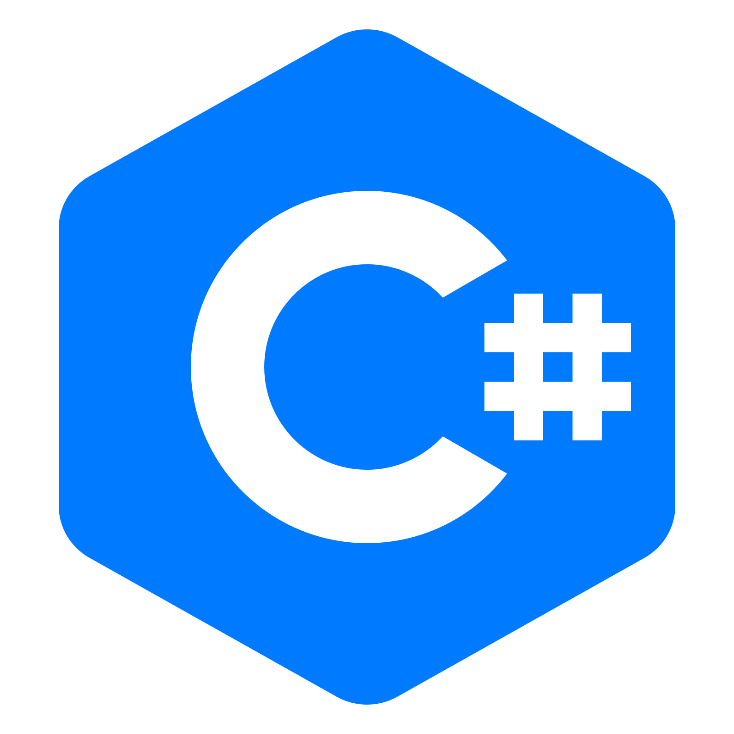

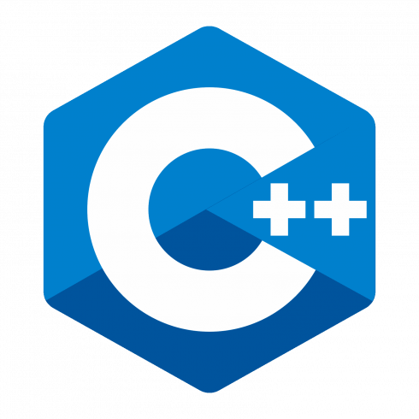
Where it plays its part.
Four Paradigms of CA:
Imperative
Sequence of commands that update state.
Declarative
Functional
Object-Oriented
Defining objects that send messages to each other.
Objects have Internal state and Public interfaces.

Slide 4
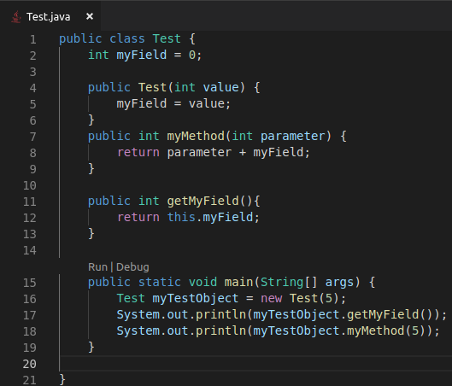
What is a Object?
An Object is a instantiated Class.
Has state and behaviour
A Class is a blueprint or template
Describes behaviour/state for a object.

Slide 5
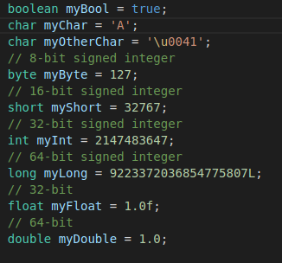
Types:
Primitive types (built-ins)
Eight types
Boolean, char, int, double
Statically typed
Forward thinking.
However Type casting.

Slide 6
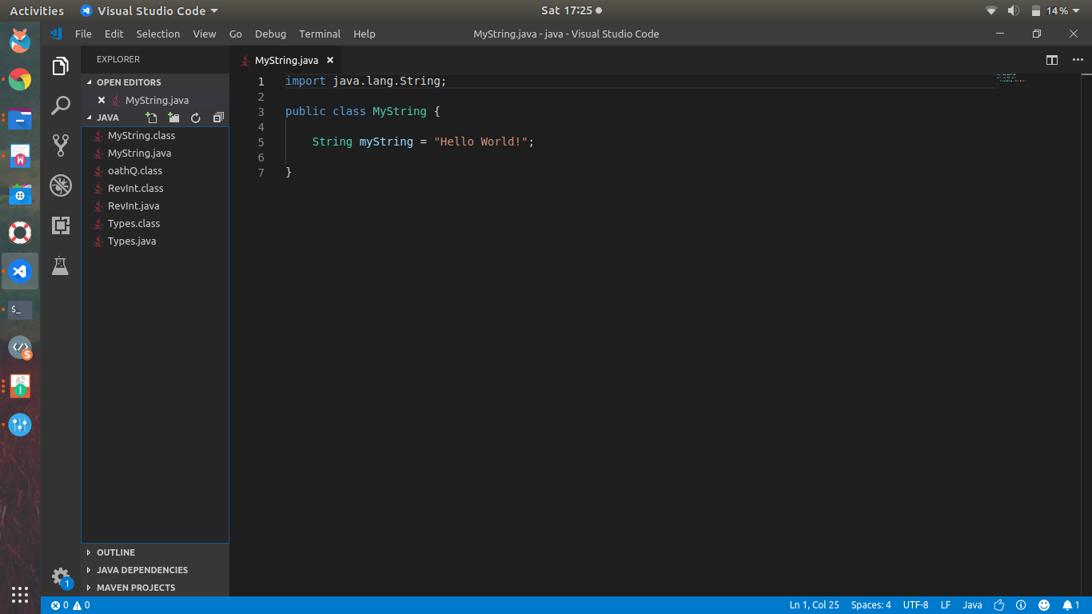
Where are Strings?!
Java wants to help you!
It’s a Object.
Methods available
Sequence Characters
Char array

Slide 7
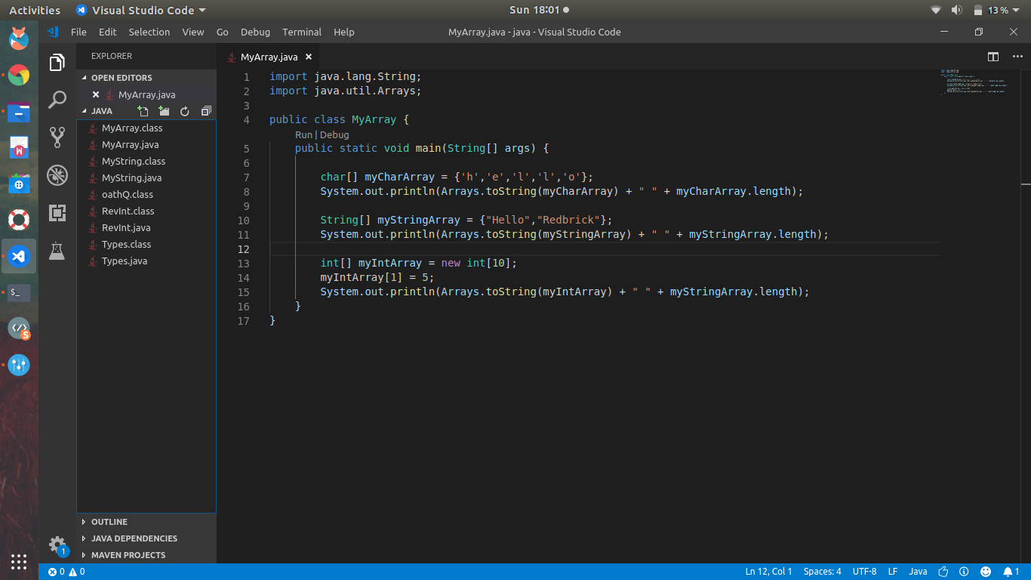
Arrays
A container that holds a fixed number of a single type.
Two approaches:
Declare and Initialize
Declare and Assign
Note: “new“

Slide 8
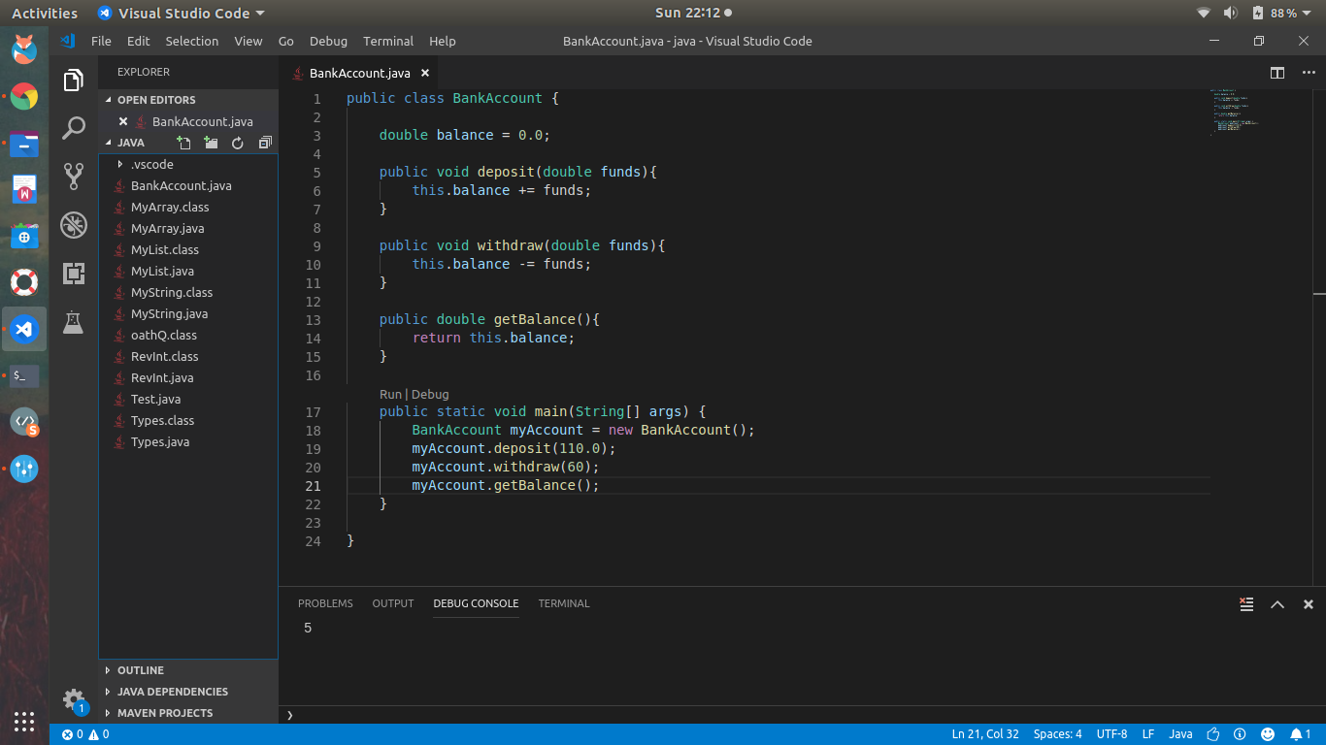
Method deep dive
Method is a function that lives within a Class
They interact with fields.
“this” keyword
Fields and Methods have a access modifiers.
public, private, protected, package protected

Slide 9
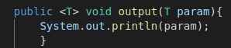
Generics
Class or Method that can take many Types.
Denoted by <T>
Reusable code

Slide 10
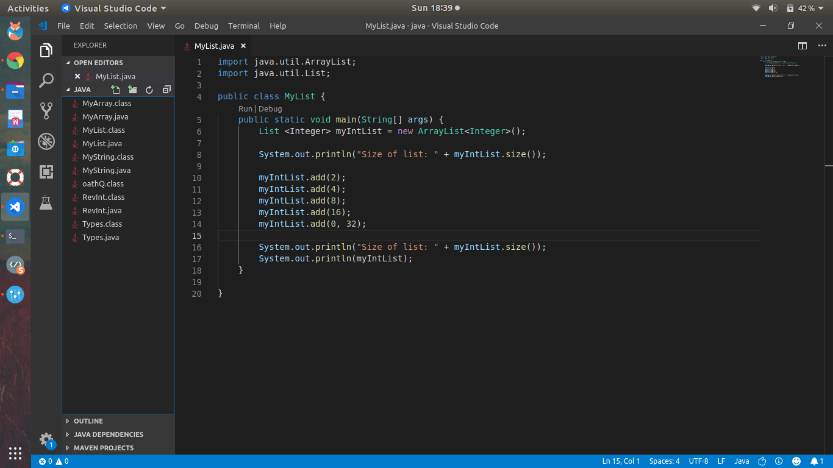
Lists
Built in Class that uses Generics.
Part of Collections Framework
Specifically List Interface
Since its a class…
There are methods
Note: “Integer” is a class.

Slide 11
Collections Framework
Provides easy access to data structures.
Eight Interfaces:
Collection Interface
List Interface
Set
Sorted Set
Map
Map.Entry
SortedMap
Enumeration
Example:
LinkedList
Trees
HashSet
Dictionary
Stack

Slide 12
Core Concepts of OOP
Inheritance
Derive a class from another class
Polymorphism
Method overloading
Encapsulation
Access Modifiers Getters and Setters, Similar ideas lumped together.
Abstraction
Only need to know methods not how they work (interface/abstract class)

Slide 13
Thinking ahead...
Imperative
“And then this happens”
Object Oriented
“And this will happen”
Difference?
Imperative is sequential and now
OOP is planning

Slide 14
Thinking ahead P2
Why two slides?
Have you ever written a program where you have repeated code?
OOP should be:
ReUsable
Extendable
Modular
Back to Concepts!

Slide 15
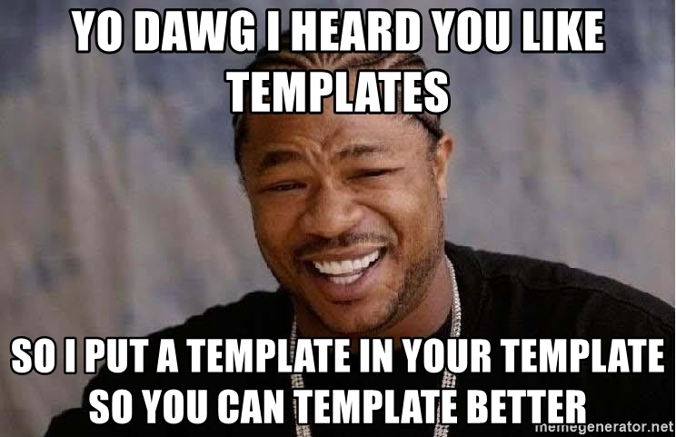
Inheritance
We want to make a zoo…
We need animals for our zoo
Tiger, Wolf, Elephant
Very boring zoo...

Slide 16
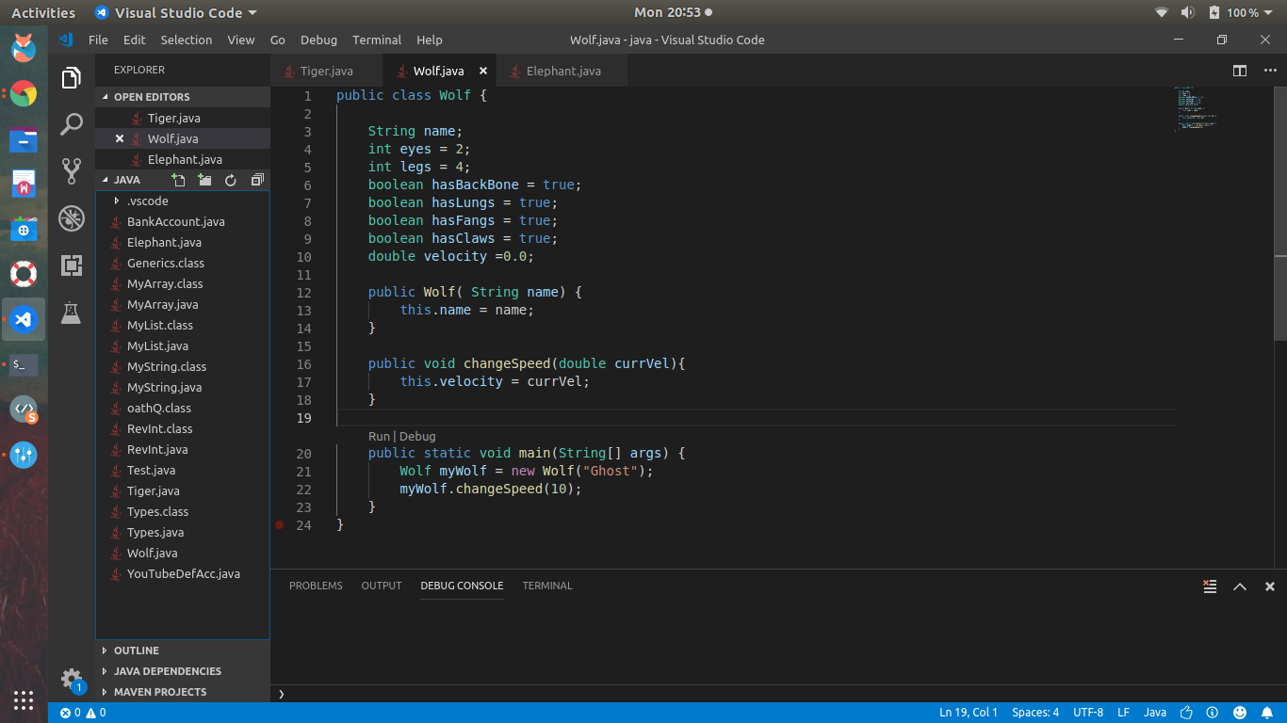
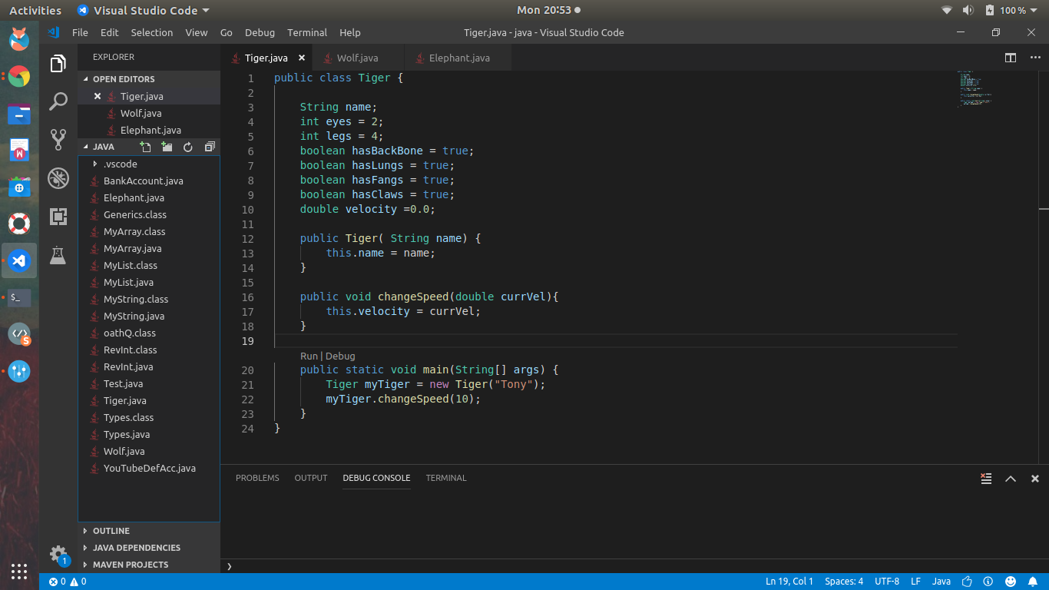
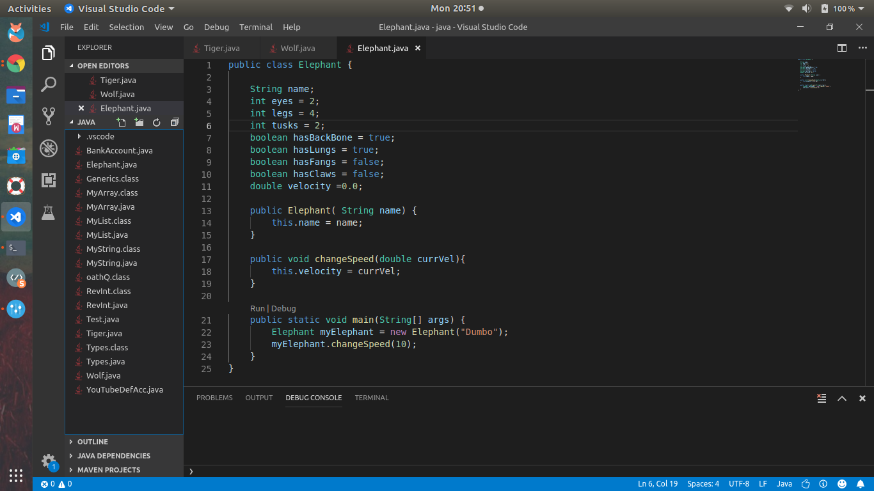

Slide 17
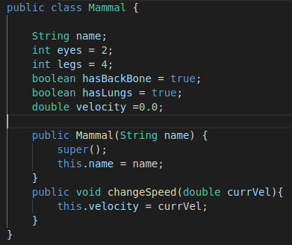

Slide 18
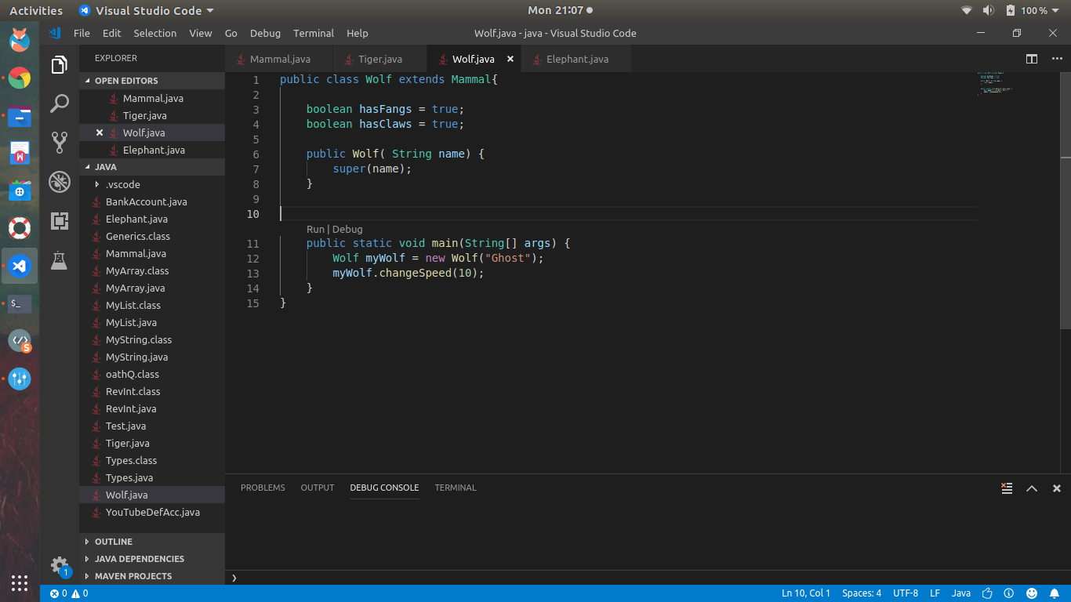
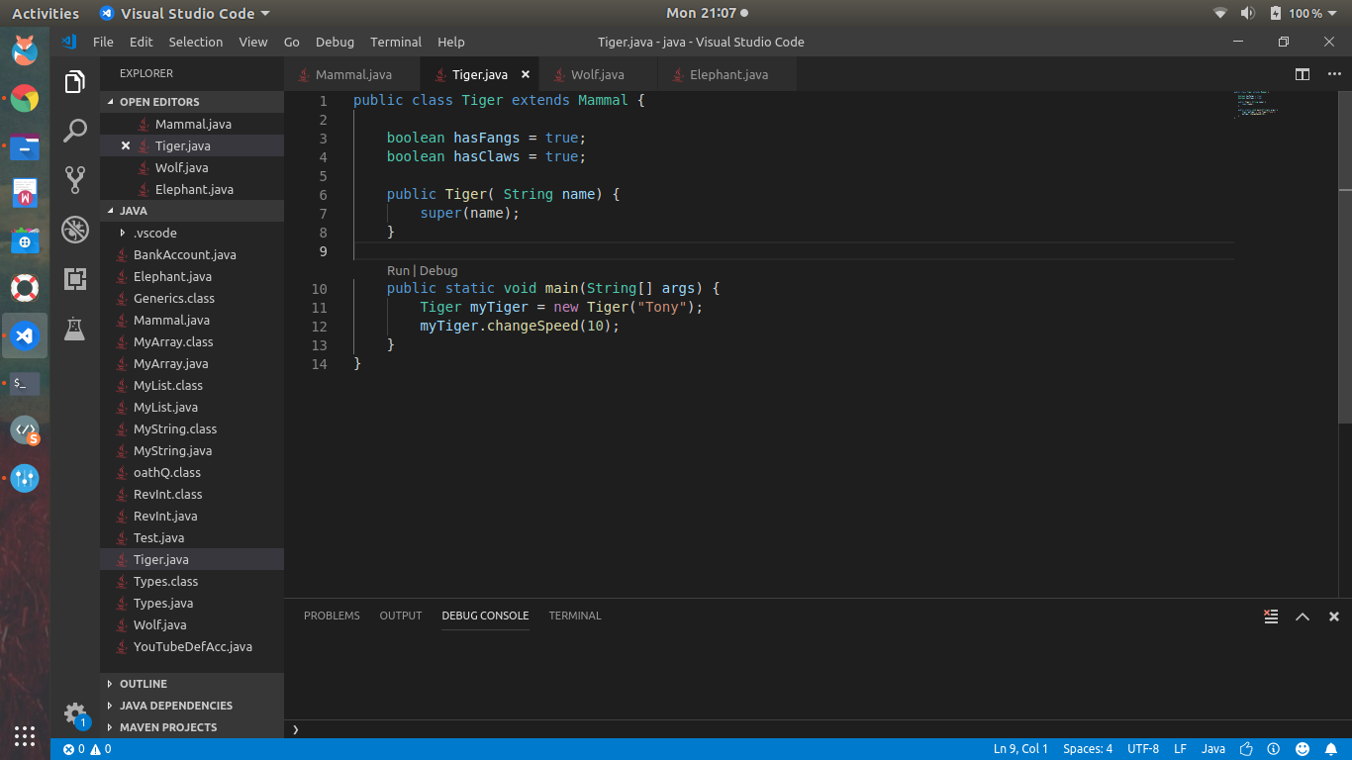

Slide 19
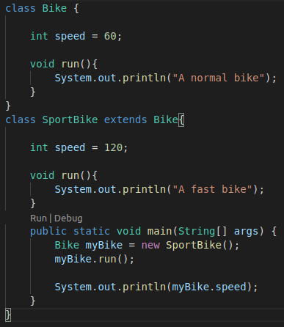
Polymorphism
Super Class has a:
Method or a field
Sub-Class has the same method or field…
What happens?
Note: Method Overloading
Can occur in same class
Notes:
Bring up Shape class if necessary

Slide 20
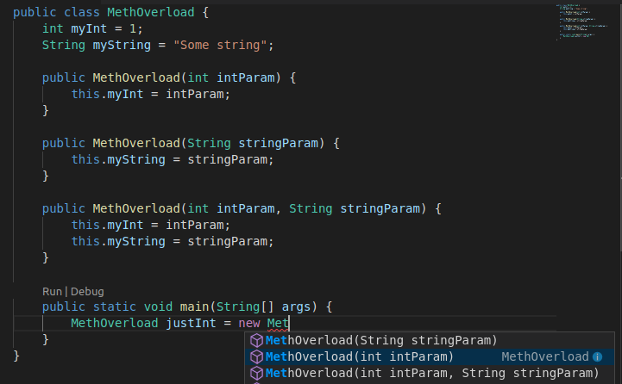
SideNote: Method Overloading
Many variations of a single method.
Note: Overloading constructor.

Slide 21
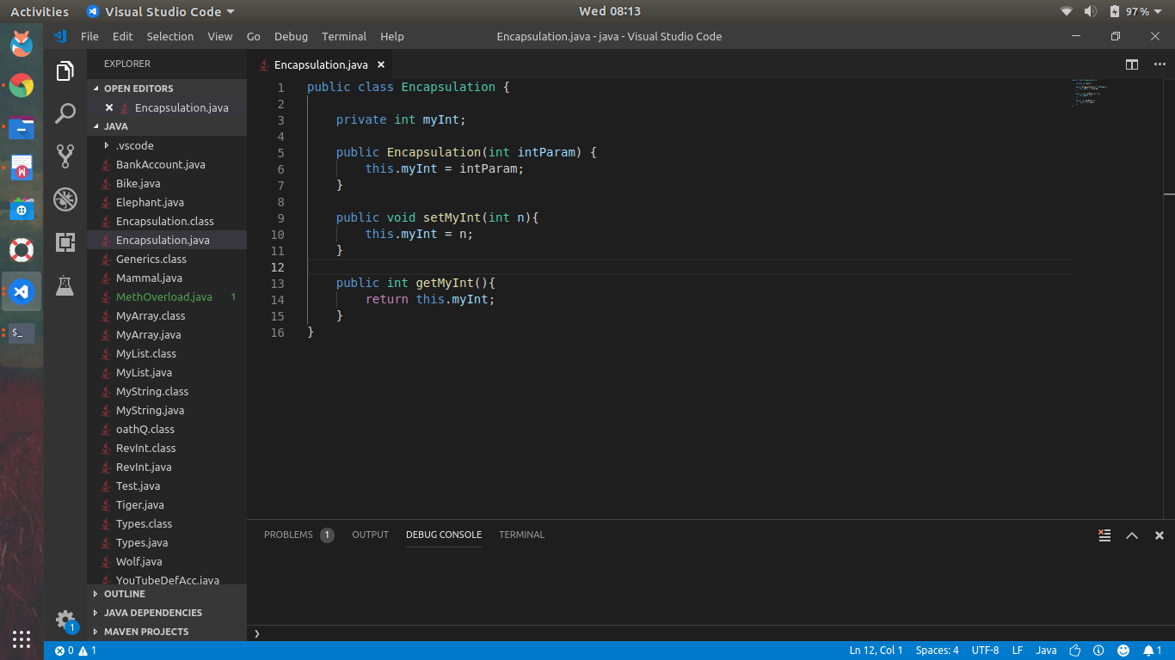
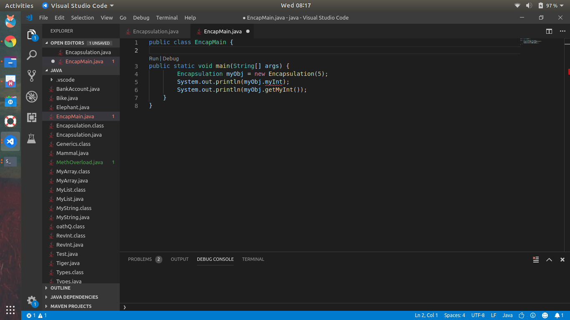
Encapsulation
Securing data within classes
This entails:
Access Modifiers
public
private
protected
Package protected
Setters and Getters
Used for accessing private data

Slide 23
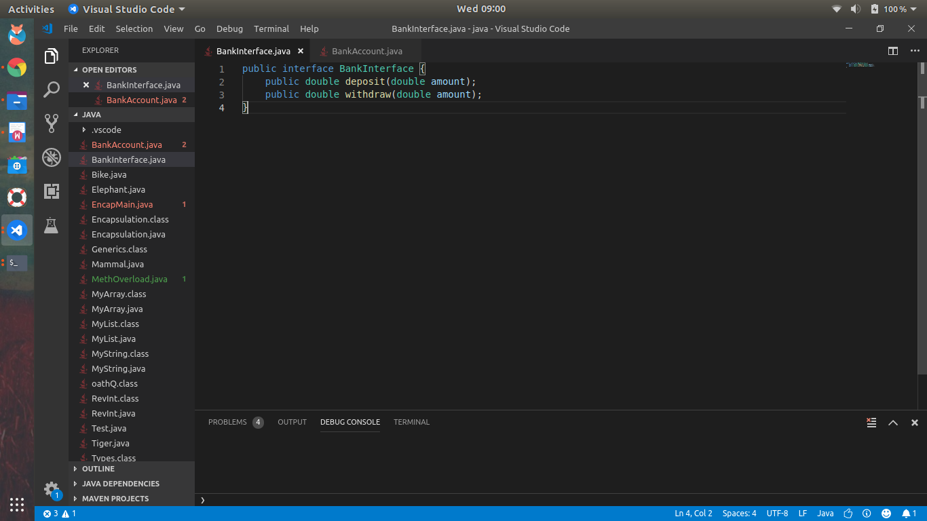
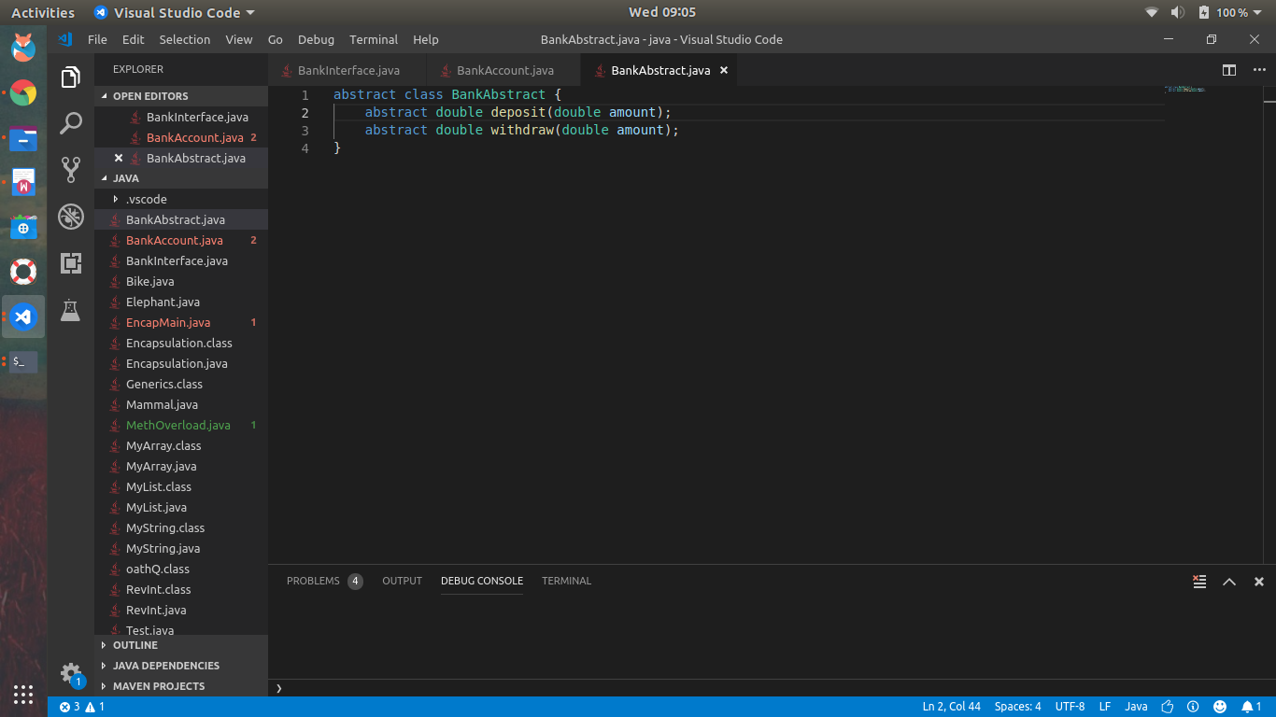
Abstraction
Don’t care how a method does something….
Once it does it right!
Example:
len()
print()
Enforced by Interfaces & Abstract classes.
Thinking ahead! again...

Slide 24
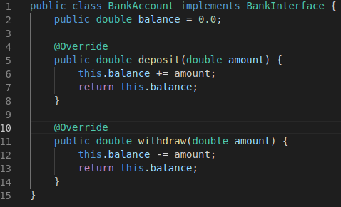
Interface vs Abstract class
All methods defined in an interface must be implemented.
This is not the case for Abstract classes
Both allow to scaffold classes!

Slide 25
Questions?!
Covered a lot
We can back pedal :)

